Slide 1
5YNOW (5 years from now)
Presented by Ekalavyan

Slide 2
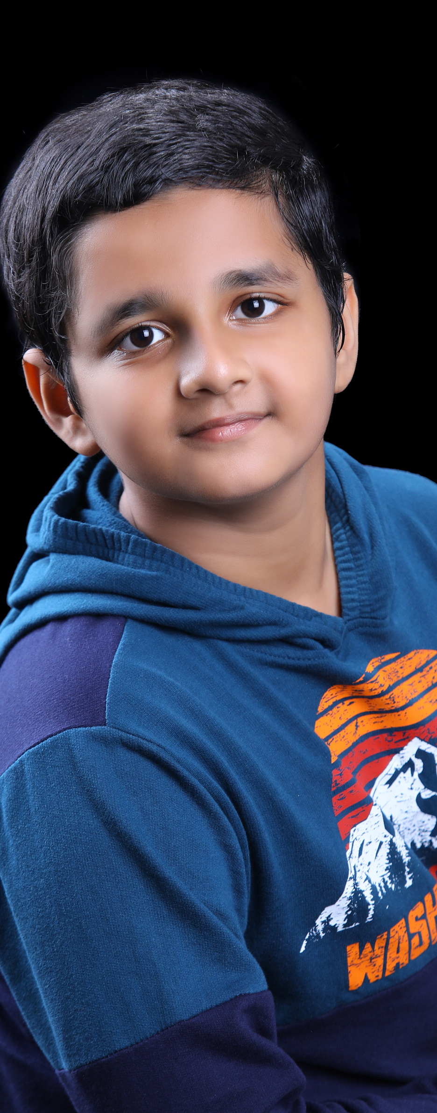

Ekalavyan - Profile
Studying in The School of the Good Shepherd
Started coding at the age of 9 and now I am 12 years old
Programming Languages Known
Html, CSS, JavaScript
React JS, React Native
Python
Express, Node JS
Database Knowledge
JSON
Firebase

Slide 3
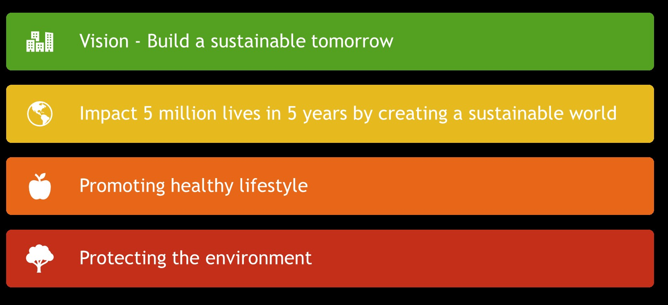
5YNOW – 5 Years from Now

Slide 4
5YNOW - Application
Features
Healthy lifestyle – Food tracking using Open AI
The food are identified using the Open AI
User accounts can be created and the user can log the food (work in progress for user food log)
Healthy lifestyle – Plastic Bottle Collector
User can collect the plastic bottles and put it for recycling and earn points
Note : Since I started the project on Saturday (18th Nov) afternoon only, the work is still in progress
I was working on the project ‘Interview Genie’ project on Thursday and Friday and started this project after the completion of that.

Slide 5
5YNow – Way Forward
Features that will be added
Food analysis using OpenAI
Points will be awarded for each healthy lifestyle and user shall be awarded with various sustainability points
User can gain points for eating healthy food, doing exercise, adding daily workouts and steps etc
User can gain points by following environment friendly habits like promoting go green, avoiding plastic, reducing fuel consumption etc
Plastic collection points shall be set with the help of investors like corporate companies or government and registered users can earn points by submitting the plastic for recycling
Various events like beach cleaning, tree planting etc can be hosted through this website
Opportunity ahead to sell the product to corporate for their CSR activities

Slide 6
Thank you

